Slide 1
Creating Logic Models
August | 2020

Slide 2
Weaving data into a story
Logic Models = YOUR
Theory of Change!
that moves people to action.

Slide 3
Logic Models = YOUR
Theory of Change!

Slide 4
Logic Models = YOUR
Theory of Change!

Slide 5
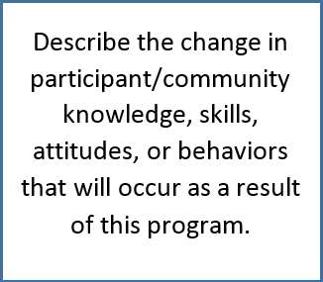
Community Condition Behavior
Planned Intention Self-efficacy Attitude
Skills Learned Knowledge Access

Slide 6
Logic Models = YOUR
Theory of Change!

Slide 7
S.M.A.R.T. Objectives
Specific Measurable Achievable Results-Oriented Time-Sensitive
Implementing the XYZ project
will result in a
realistic % or #
change in outcomes
among specific population
by specific date.
Post on board

Slide 8
Logic Models = YOUR
Theory of Change!

Slide 9
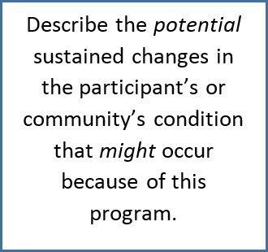
Community Condition Behavior
Planned Intention Self-efficacy Attitude
Skills Learned Knowledge Access

Slide 10
Logic Models = YOUR
Theory of Change!

