Slide 1


NPO KICKOFF
September 15, 2025

Slide 2
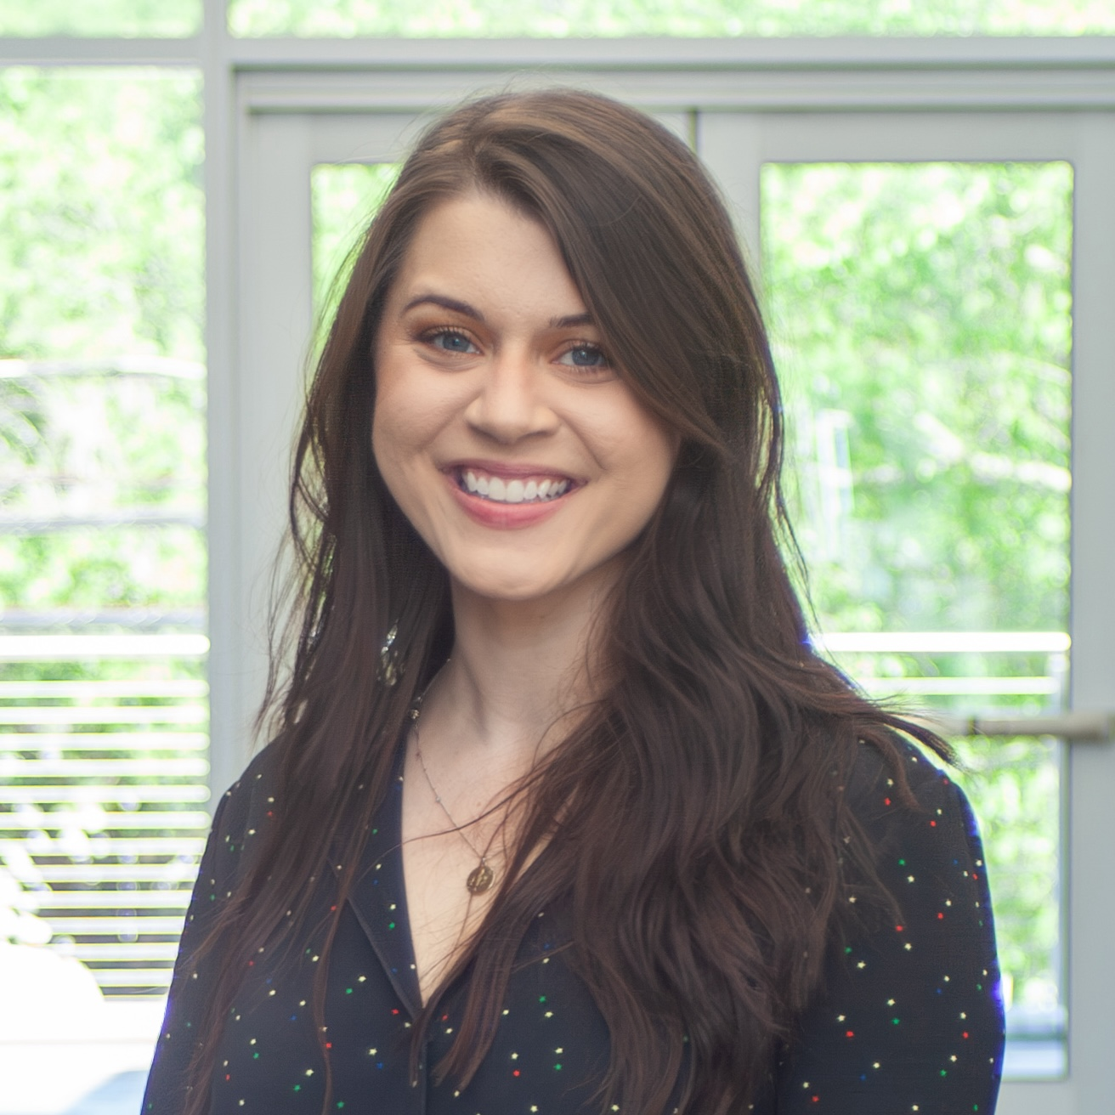
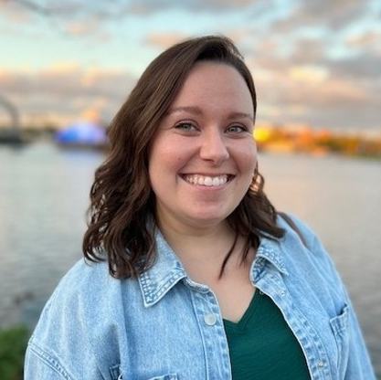
Meet the Give Local 2025 Team!
Savannah Crosby
Emma DeVenny
Cianne Maloney (Bonterra)

Slide 3

Getting Ready for Give Local!
November 14, 2025
Notes:
🗣️ Presenting Tips: Have water available, take a deep breath, and don’t be afraid to speak slowly and take pauses when you need to. You’ve got this! 🤩
⚠️ Make sure you are recording! ⚠️
💡 Use the “Find and replace” feature on Google Slides to update the “snippets” for this presentation. Below are the list of “snippets” you can replace with specific information for your giving day. 💡
Give Local!
Give Local! (same as DoG)
[DoG URL]
[Partner Organization]
[Year]
Presenter Notes:
Welcome attendees
If starting right at start time, feel free to wait up to 2 additional minutes to allow for additional attendees to join
Presenter Script:
Hello everyone and welcome! I’m so glad that you all are joining today’s webinar on Getting Ready for Give Local!. We’re going to wait a couple of extra minutes to allow folks to sign on, and get started at –:02.

Slide 4

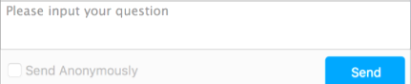
Submit Your Questions
Chat Box
Q&A
If you have questions or comments throughout our training,
please write in using your Zoom webinar attendee panel.
Notes:
Presenter Notes:
Housekeeping/Etiquette reminders
Everyone is on mute to keep noise levels to a minimum
This is being recorded, and will be available on the /trainings page by X date
Find your Zoom panel and chat in
Please say hello in the chat
Let us know your name, organization, and how many times you’ve participated in Giving Day
Questions? Use Q&A. We’ll save plenty of time at the end.
Presenter Script:
Just a few housekeeping notes before we jump into today’s presentation. This webinar is being recorded so you’ll be able to revisit the presentation at your convenience, or share it with someone who wasn’t able to attend today.
You are all on mute in order to keep the noise levels to a minimum - however we do encourage questions, so please take a moment to locate your Q&A box now and we’ll save time at the end to address all of your questions.
As a friendly reminder, please be sure to submit any questions that you have through the Q&A box rather than chat. This will help us ensure that your questions don’t get missed.
With that said, please take some time to write into the chat now and let us know what organization you’re representing today, as well as whether you’re a Give Local! veteran or if this is your first time participating.

Slide 5

Agenda
Give Local! Overview
Who is Bonterra?
Creating Your Profile
Next Steps & Questions
Notes:
🖌️ Design Note: Keep titles short and to the point. Leave extra information for when you present
Presenter Notes:
Quick overview of the agenda
Presenter Script:
So with that, let’s jump right in!
Here’s a quick summary of what we’re covering in today’s presentation.
We’ll be going over everything from the basics of Give Local!, to how to register and set up your profile, and end with a quick checklist of your next steps and Q&A.
There is a ton of great information in this presentation, so just a friendly reminder that the slides and recording will be available online later today [or tomorrow] for review.

Slide 6
Give Local! Overview
givelocalsc.org l November 14, 2025 12am-11:59 pm
Every nonprofit conducts their own unique campaign to market and share with their supporters
Your marketing efforts + Arras Foundation Efforts = Exponential visibility
IRS-recognized nonprofit serving Lancaster and Chester County are eligible to participate
Leaderboards for friendly competition, prize incentives
Donations open on November 11 date and close December 3
Notes:
Presenter Notes:
Every nonprofit conducts their own unique campaign to market and share with their supporters
IRS-recognized nonprofit serving [DoG community] are eligible to participate
Your marketing efforts + [Host] Efforts = Exponential visibility
Leaderboards for friendly competition, prize incentives
Donations open on X date
Presenter Script:
I’ll start with the basics -
Give Local! is a 24-hour [customize if needed] giving day taking place online at [DoG URL]. It is taking place on [DATE] from [TIME] to [TIME].
For Give Local!, each nonprofit organization will conduct their own unique campaign to market and share with their supporters. All participating nonprofits will need to register and complete their profile for Give Local!. And don’t worry - I’ll cover both of these processes shortly.
Participants in Give Local! will receive exponential visibility generated by their own marketing efforts to spread awareness about the day, as well as the efforts of [Partner Organization]. By being a part of the momentum of Give Local! and leveraging the tools available to you through your participation, your organization has the potential to reach a brand new audience of supporters.
In order to participate, organizations must be an IRS recognized tax-deductible nonprofit, and in compliance with state solicitation requirements.
[CUSTOMIZE IF CENTRALLY ROUTED] Additionally, you’ll need to be able to accept ACH deposit transfers into a valid checking account. This is how you will receive the funds that are raised on Give Local!.
An exciting benefit to participating in Give Local! is the opportunity to participate in friendly competition via leaderboards [and to win prizes throughout the day.]
[If applicable] To provide the maximum number of opportunities for supporters to get involved and donate, donations will open early on [DATE] and close on [DATE.] includes your offline donations
Hannah to jump in to talk matches

Slide 7

Benefits of Participating
Learn to utilize digital fundraising tools, and take advantage of resources that are available year-round!
Re-Engage with your existing supporters and gain new donors
Combine your marketing efforts + Arras Foundation marketing = exponential visibility for all organizations
Utilize the Giving Day to reach other internal goals
Motivate donors to make a greater impact with prizes and match incentives
Notes:
Presenter Notes:
So what are the additional benefits of participating in Give Local!?
Learn to utilize digital fundraising tools, and take advantage of resources that are available year-round!
Re-Engage with your existing supporters and gain new donors
Combine your marketing efforts + [Host Team] marketing = exponential visibility for all organizations
Utilize the Giving Day to reach other internal goals
Motivate donors to make a greater impact with prizes and match incentives
Presenter Script:
So what are the additional benefits that your organization will receive as a result of participating in Give Local!?
By participating in in Give Local!, your organization has the opportunity to learn how to utilize new digital fundraising tools, and take advantage of the fundraising resources that are available year-round on the site. Bonterra and [Partner Organization] provide numerous resources on general fundraising geared specifically towards Give Local!, but that can be accessed and used year-round to provide inspiration and best practices for fundraising, engagement, and stewardship.
Participating in Give Local! provides the the opportunity for your organization to re-engage and strengthen relationships with your existing supporters, as well as gain new donors and supporters. For example, Give Local! can present an opportunity for volunteers to assist with marketing or P2P fundraising efforts, which allows those supporters to engage with your organization at a higher level.
By participating, you are capitalizing on the momentum of a [state/county] wide day to get your organization in front of new audiences. Participating in Give Local! means that you are combining your marketing efforts with [Partner Organization]’s marketing efforts, which will provide exponential visibility for all participating organizations.
Give Local! can also be used as a way to reach other internal goals that your organization has. We encourage all participating organizations to identify some goals that go beyond dollars raised that Give Local! can help to achieve. For example, you can use Give Local! to increase volunteer participation, increase social media followers, [increase recurring donations], or enhance stewardship programs.
Additionally, because there are prize and match incentives on the day, this is an incredible motivator for donors. Donors will be incentivized to make a greater impact on the day knowing that their dollars go further thanks to sponsor matching and prize opportunities
[I’d love to hear in the chat from some organizations that utilized Give Local! to reach internal goals whether it be dollars raised, donors, or social media followers. Please feel free to write in now and share with others what goals Give Local! has helped your organization to achieve.]

Slide 8

Who is
Bonterra?
Notes:
Presenter Notes:
Now that I’ve covered the basics, I’d like to tell you a little more about Bonterra and who we are.

Slide 9

Who is Bonterra?
Bonterra’s mission is to power those who power social impact
Host a secure, reliable and transparent platform for Give Local!
Create the ultimate donor experience
Provide a dedicated support team
GiveGab is becoming Bonterra!
Notes:
Presenter Notes:
Bonterra’s mission is to make it incredibly easy for fundraising professionals to be great at their jobs!
Technology partner for Give Local!
Aim to provide the ultimate, easy to use and enjoyable donor experience
Dedicated support team
GiveGab is becoming Bonterra
Presenter Script:
Bonterra’s mission is to power those who power social impact.
As Give Local!’s technology partner, we provide the platform where you will register for and complete your profile for your giving day. [For those of you that have participated in the past, you’re already familiar with the giving day dashboard where you manage all things Giving Day.] Each year, you will be able to log in and use the same account to manage your participation in Give Local!. We strive to make registering and completing your profile as easy and enjoyable as possible, and we’ll cover this process more in depth in just a little while!
Not only do we strive to make your experience of participating in Give Local! as seamless as possible, we’re also dedicated to providing the ultimate donor experience. In addition to providing a secure, reliable, and easy to use method of donating, all donors are automatically receipted immediately upon making their donation.
Here at Bonterra, we encourage you to think of us as an extension of your team. As such, we provide a dedicated support team to help you, [your P2P fundraisers,] and donors with any questions that you may have about the platform. In addition to providing email and chat support during regular business hours, we offer an extensive Help Center where you can easily find answers to your questions 24/7. No question is too big or small for our support team - if you have technical questions about registering, or simply want someone to offer feedback on filling out your profile, our team is here to help.
GiveGab is becoming Bonterra! If you see the name “GiveGab” anywhere, don’t worry, that’s us! This doesn’t change your participation in Give Local! or impact the tools we’re going to review in today’s webinar, and you’ll continue to receive the same customer love and support you always have!

Slide 10



Donation Security
Partnered with Stripe - PCI Level 1 Payment Processor for donation processing
Direct deposit funds within 5-7 business days
Your banking information is reviewed by Stripe
Donor credit card information is not revealed or saved in Bonterra
All participating organizations verified as IRS and state-recognized nonprofits
Notes:
Presenter Notes:
One of Bonterra’s top priorities is security and reliability.
Bonterra partners with Stripe, a PCI Level 1 Payment Processor for secure donation processing
Funds are deposited into your bank account within 5-7 business days
Banking information is entered and securely passed through an reviewed by Stripe
Donor CC info is not revealed or saved in Bonterra
All participating organizations are verified as IRS and state-recognized tax-deductible organizations
Presenter Script:
One of Bonterra’s top priorities is security and reliability.
To ensure this, Bonterra partners with Stripe, a PCI Level 1 Payment Processor for secure donation processing.
Donor payment information is never revealed or saved within Bonterra, but instead securely passed through to Stripe for processing.
When a donor gives to your organization, funds are deposited directly into your bank account within 5-7 business days. In order to become verified to receive donations, your organization must have a bank account that can accept ACH transfers. When setting up your direct deposit, your information will be securely passed through and verified by Stripe.
Additionally, Bonterra verifies that all participating organizations are verified as IRS and state-recognized nonprofits. By doing this, we ensure that donors can feel confident that they’re giving to who they think they are.

Slide 11
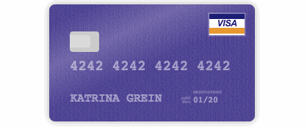
Simple Donation Processing
All major credit cards accepted
Log right into your bank to use the Plaid/ACH payment
Quick, easy and fun donation flow
Securely processed through Stripe
Chat support available right within the donation form for your supporters!
Notes:
Presenter Notes:
Bonterra provides simple donation processing to ensure that the donor experience is easy and enjoyable.
All major credit cards accepted
Log right into your bank to use the Plaid/ACH payment
Quick, easy and fun donation flow
Securely processed through Stripe
Chat support available right within the donation form for your supporters!
Presenter Script:
Bonterra provides simple donation processing to ensure that the donor experience is easy and enjoyable.
All major credit cards accepted.
[Additionally, donors giving over $X amount can make their gift by logging directly into their online bank to take advantage of lower processing fees - but more on that later!]
When exploring [DoG URL], donors will have the option to add donations to their gift basket. This provides them an easy way to keep track of the organizations that they want to give to, while exploring additional organizations throughout the site. When it comes time to check out, they’ll have the option to easily view their gift basket and complete their donations.
We process all transactions securely using our payment processor, Stripe, which, as mentioned earlier, is a PCI Level 1 Compliant payment processor. This is the highest level of compliance available.
Although our donation process is simple, fun, and easy to use, we understand that questions can come up. We understand how important is to have support available during the critical moments of a donor actually making their gift. Because of this, we have chat support available right within the donation form for easy access to our support team every step of the way!

Slide 12
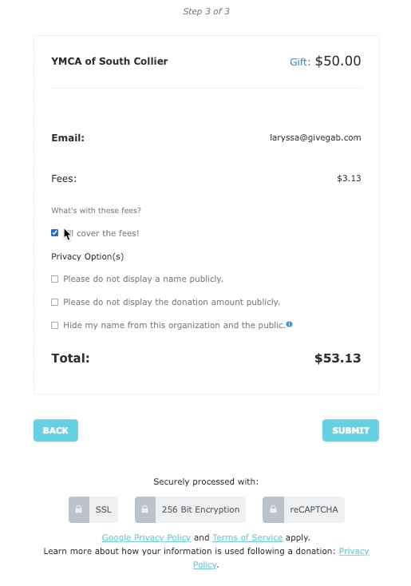
Transparent Donations
Credit Card, ACH, Mobile Pay for online transactions
Donors can cover all fees on behalf of your organization
Historically, donors cover 91.5% of fees during a Give Local!
Notes:
⚠️ SUBSTITUTE FEE PERCENTAGE: Update with % from last year, as well as effective rate. (If effective rate was .85, it cost $0.85 per $100 raised online to fundraise during the DoG) ⚠️
Presenter Notes:
Quick example of what the final step of the donation process looks like.
Historically, donors cover X% of fees during a Giving Day [For returning: Last year, donors covered X% of fees during Give Local!]
This means that it only cost $X per $100 raised online!
Presenter Script:
When donors give through Give Local!, they will have the option to cover the donation processing fees in the last step of the donation form. While this is totally optional, we find that historically X% of donors cover fees during a giving day. [For returning: While this is totally optional, last year X% of donors covered the fees when making their gift during Give Local!].
This means that it only cost $X per $100 raised online! Although there is always a cost to raising funds online, donors are not always aware of these costs. By providing transparency around fees, most donors are willing to cover them to ensure that their recipient organization receives 100% of their intended donation.

Slide 13


Transparent Donations
Credit Card:
3% Platform Fee
+
$0.30 per transaction & 2.5% transaction fee (Stripe)
=
5.5% + $0.30
ACH:
3% Platform Fee
+
$3.00 flat bank fee
=
3% + $3.00
*$100 minimum
Notes:
Presenter Notes:
So what fees are associated with making a gift during Give Local!? Explain above fee structure.
Presenter Script:
So what fees are associated with making a gift on Give Local!?
When making a gift via Credit Card, the fees for making a gift on Give Local! are 3% platform fee + 2.5% + $0.30 transaction fee. This equals a total of 5.5% + $0.30 when making a donation via Credit Card.
For donations over $100, donors have the option to give via Credit Card or via direct ACH. This means that they’ll have the option to connect their online banking account to make a gift directly from there to Give Local!. The fees associated with this method are a 3% platform fee, plus a flat, $3 bank fee for a total of 3% + $3. Donors who are giving in larger amounts appreciate having this option to save on fees, and like we saw earlier, X% of donors have historically covered the fees bringing the cost of fundraising down to just $X per $100 raised online.

Slide 14
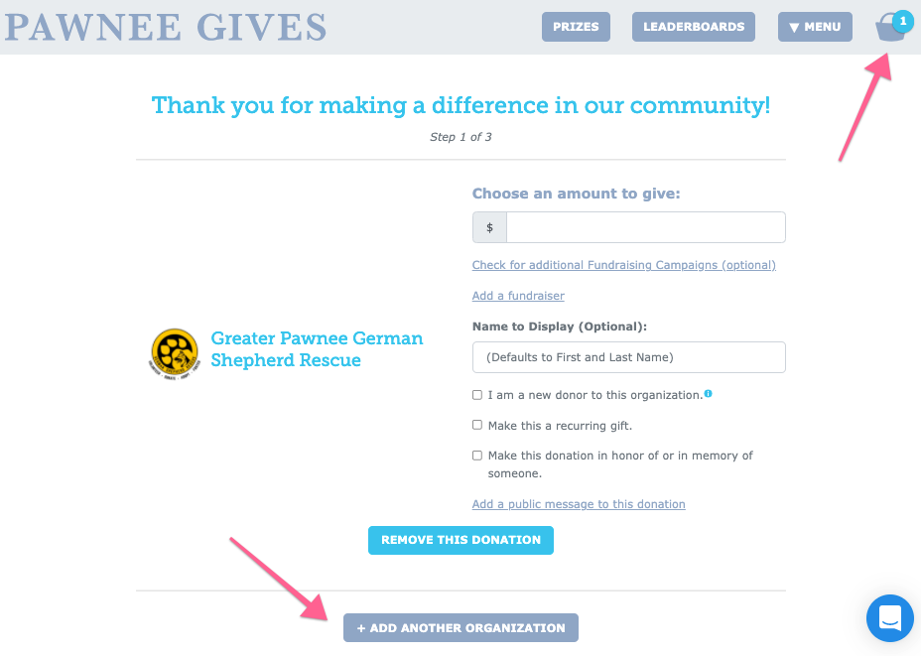
The Gift Basket makes it easy for donors to support as many causes as they like!
Notes:
Presenter Notes:
Gift basket feature
Donors can add organizations to their gift basket to keep track of where they’d like to give as they browse the site
Donors can add organizations to their gift basket by selecting that option on each organization’s profile, OR by selecting “+ Add Another Organization” right within the donation form.
Presenter Scripts:
On this slide, you can see an example of our awesome Gift Basket feature that I mentioned earlier
Donors can add organizations to their gift basket to keep track of where they’d like to give as they browse the site.
Donors can add organizations to their gift basket by selecting that option on each organization’s profile, OR by selecting “+ Add Another Organization” right within the donation form.
This makes it easy for donors to support multiple organizations in one smooth transaction!

Slide 15
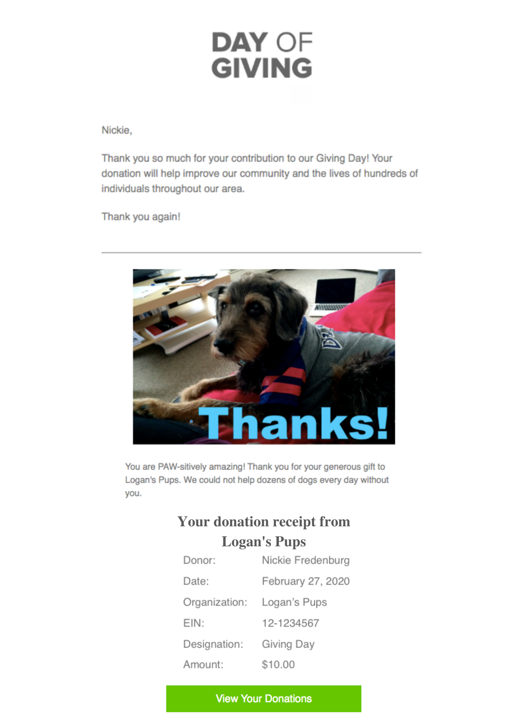
Instant Donor Delight
A Thank You email that comes from your organization
Sent immediately after the gift is made
Includes your organization’s EIN and donation amount to act as a tax-deductible receipt
Notes:
Slide note: Modify slide as needed if giving day is centrally routed.
Presenter Notes:
A Thank You email that comes from your organization
Sent immediately after the gift is made
Includes your organization’s EIN and donation amount to act as a tax-deductible receipt
Presenter Script:
Once donors make their donation, they will immediately receive a thank you email that comes from your organization’s main contact listed in the Bonterra Giving Day platform.
This thank you letter can be customized to include a special message from your organization, and we’ll cover more details on how to personalize this a little bit later in today’s presentation!
Because the thank you email will include your organization’s EIN and donor’s donation amount, this serves as a tax-deductible receipt to your donors.

Slide 16
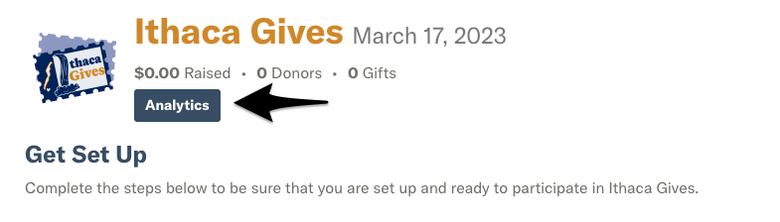
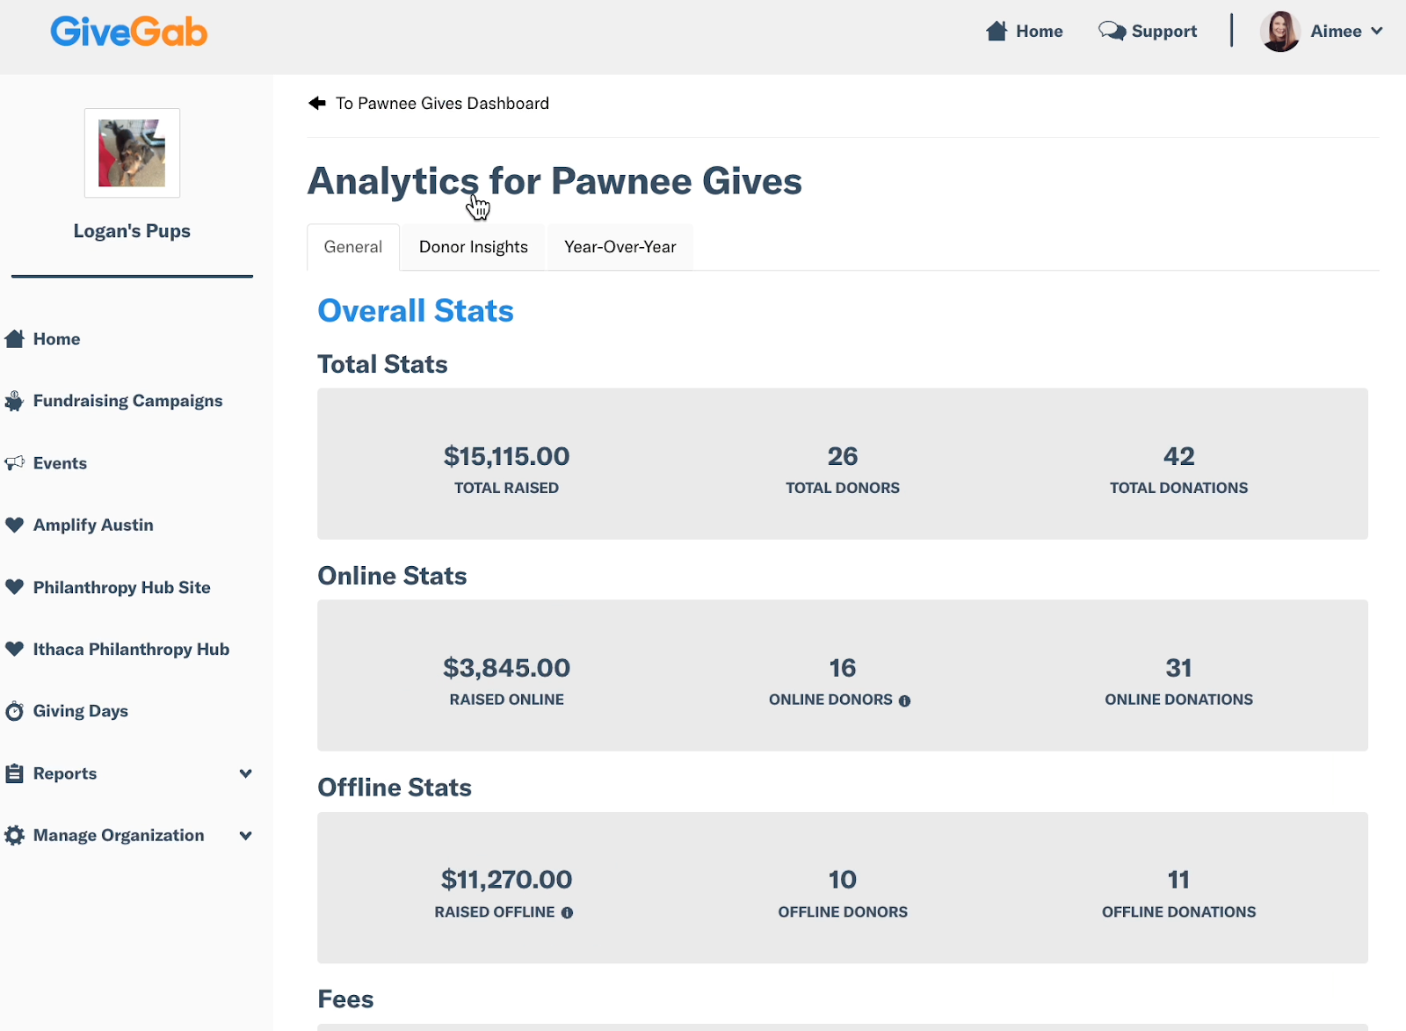
Giving Day Analytics
Key stats are available for the following data points:
Donor counts (online, offline, total)
Donation counts (online, offline, total)
Average donation size
Average donations per donor
New donors
Fee coverage
Year-Over-Year comparisons

Slide 17
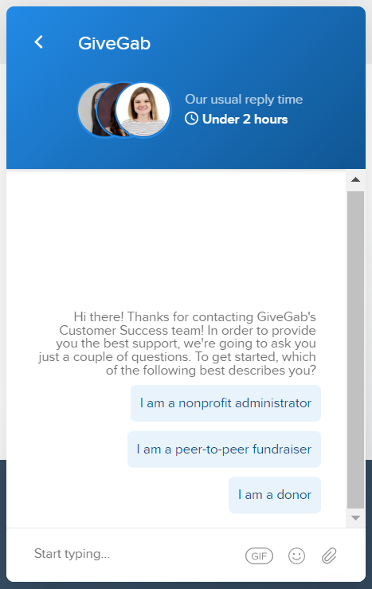


Giving Day
Support &
Resources
Visit our Help Center
Check out Our Blog
Chat with our Customer Success Team
Look for the little blue chat bubble
Notes:
Presenter Notes:
Highlight our Help Center, which is available 24/7
Our blog for tips and tricks
Chat in using the blue chat bubble
Presenter Script:
We have a dedicated Customer Success team available to help answer any questions that may come up at any time throughout this process, in addition to hundreds of support articles that are available online 24/7.
We also have an extensive blog where you can find tips, tricks, and strategies to take your giving day to the next level.
To get in touch with our Customer Success team,simply write into the little blue chat bubble with your question.
Our team is here to help you succeed, so remember that no question is too big or small to ask.

Slide 18
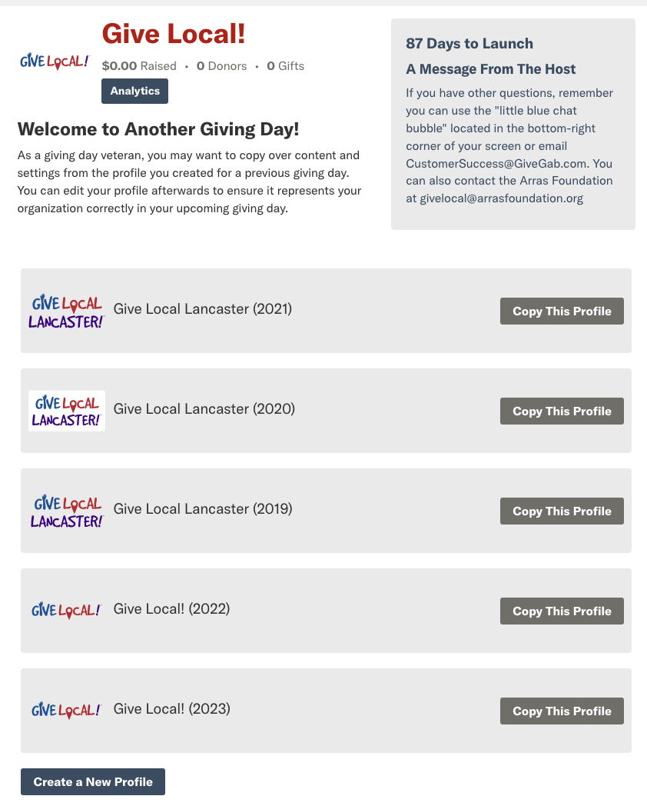
Returning?
Copy Your Profile
Don’t forget to review and update your profile after!
Existing bank information will carry over
  Double check that your bank account, org rep and admins on your profile are up to date!
Notes:
Note: Update the screenshot with an example from the giving day.
Presenter Notes:
Returning organizations have the option to copy over their profile
Presenter Script:
Once you’ve submitted your registration, you’ll have the option to copy over your profile from a previous year. This will enable you to simply update existing content rather than start from scratch.
Note that your bank account information will carry over automatically from previous years even if you don’t choose to copy over your profile.

Slide 19

Completing Your Profile
Notes:
Presenter Notes:
Now that we’ve walked through how to register for Give Local! [Year], we’ll walk you through each step to completing your profile to ensure it is giving day ready!

Slide 20
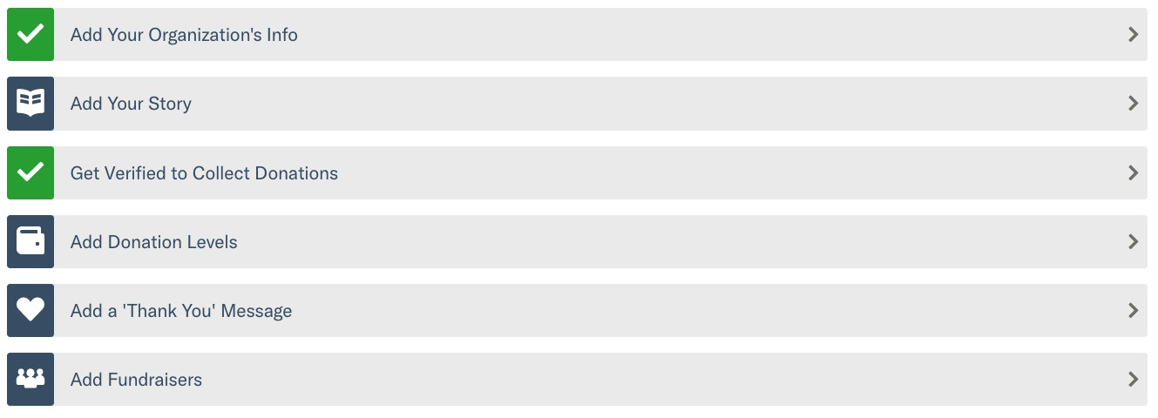
Your Giving Day Dashboard
Notes:
Presenter Notes:
Each blue box represents an area of your profile that has yet to be completed
Each green check mark represents an area of your profile that is already complete
Presenter Script:
Once you’ve completed registration, you’ll be taken to your Giving Day Dashboard. This will be your home base for managing your profile for Give Local!.
Each blue box represents an area of your profile that has yet to be completed, and each green check mark represents an area of your profile that is complete.
In order to set your profile up for success, we recommend that you complete each section of your profile.
Over the next few minutes, we’ll cover each of these steps more in depth.

Slide 21
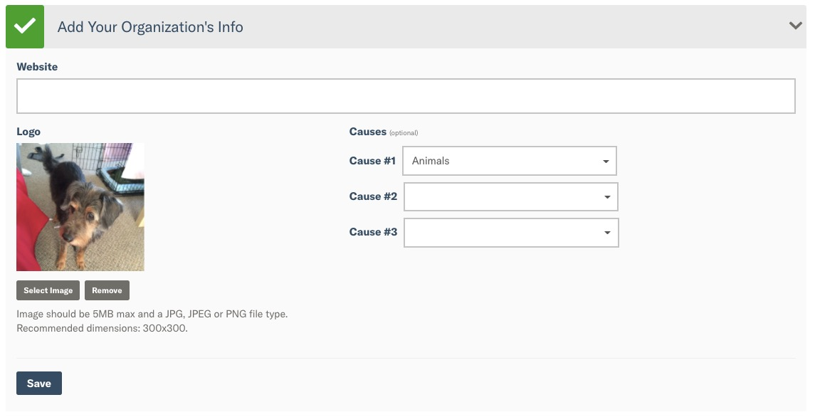
Basic Info
Logo
Website
Causes
Pro Tip: Adding causes to your profile can help new donors find you by our cause-based search!
Notes:
Presenter Notes:
Logo
Website
Causes
Pro Tip: Adding causes to your profile can help new donors find you by our cause-based search!
Presenter Script:
The first step to “Add your organization info” will prompt you to add in some basic information about your organization, such as logo, website, and causes.
Each of these fields are important as they each serve a purpose in helping donors find your profile on [DoG URL].
Uploading a high quality, square version of your logo will ensure that your visual identity on your profile is recognizable to existing and new supporters.
Additionally, entering the top three causes that your organization identifies with will help donors that are searching for new organizations to support find your org.
For example, if you identify with the “Animals” cause, donors can use our new cause based search to find your organization.

Slide 22
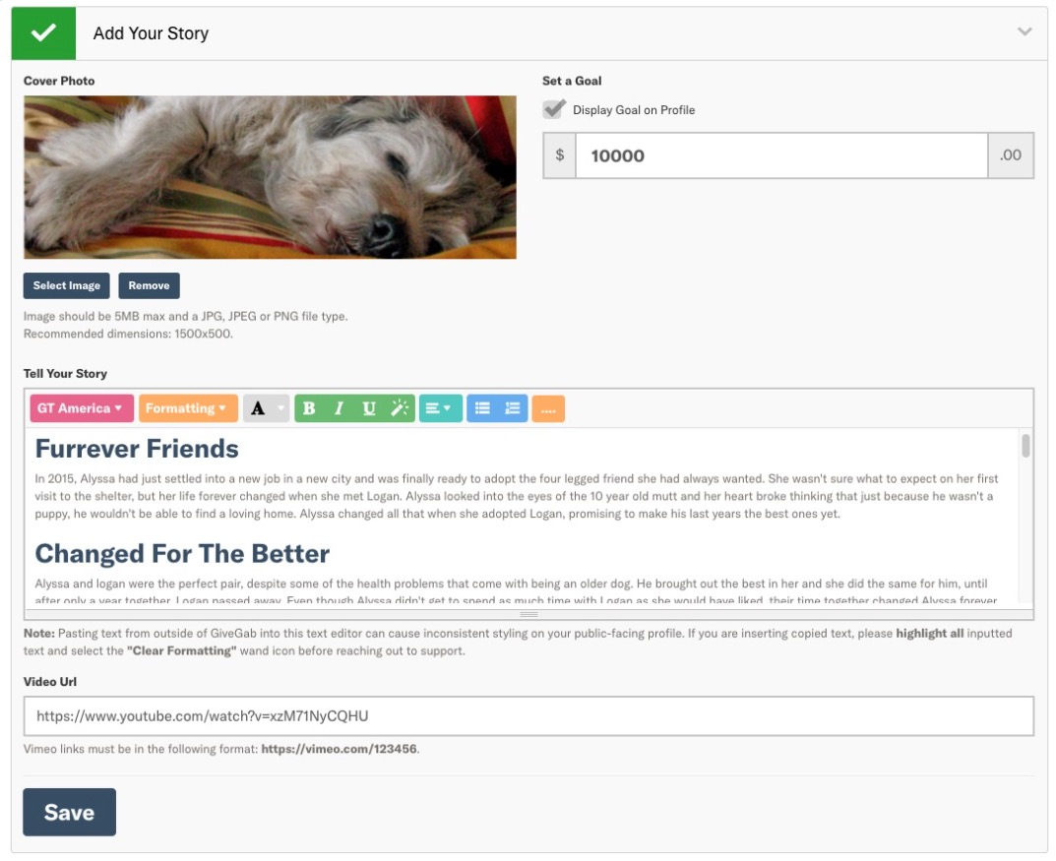
Curate Your Story
Add a cover photo
Set a monetary goal
Tell the story of your organization’s participation in the giving day through words and visuals
Notes:
Presenter Notes:
Add a cover photo
Set a monetary goal
Tell the story of your organization’s participation in the giving day through words and visuals
Use this as an opportunity to make an emotional appeal to your donors
Presenter Script:
Once you’ve filled out the basic information about your organization, you’ll move on to the next step on your Giving Day Dashboard which is to add your story.
In this section, you’ll be prompted to add a cover photo, set a monetary goal, and tell the story of why your organization is participating through both words and visuals.
I want to take a moment to stress the importance of adding a thoughtful story to your Giving Day profile. For donors that are not familiar with your organization yet, this will be their only opportunity to get to you know organization and why you’re raising funds. Testimonies, first-hand accounts from beneficiaries, or a letter from your President making a personal request for support, all are great examples of ways to make an emotional appear to your audience for their support.
In addition to using words to share your organization’s story, we encourage you to use photos and videos whenever applicable. If your organization cannot use photos of beneficiaries for privacy reasons, there are tons of free stock images available to help illustrate your story with visuals.

Slide 23
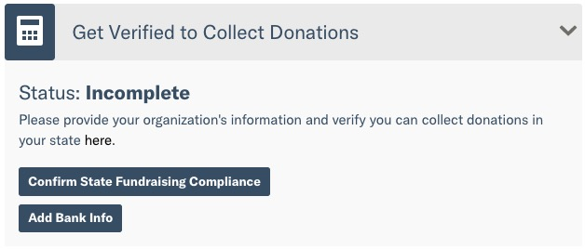
Get Verified
State Attestation Compliance
Basic information about your organization
Banking information for your organization
Organization Representative information
This is separate from your “application” process to participate
Pro Tip: Don’t wait to complete this information. It can take at least several days, and in some instances more
Notes:
Presenter Notes:
State Attestation Compliance
Basic information about your organization
Banking information for your organization
Organization Representative information
This is separate from your “application” process to participate
Pro Tip: Don’t wait to complete this information. It can take at least several days, and in some instances more
Presenter Script:
The next step on your Giving Day dashboard is one of the most important steps - getting verified to receive donations! Without completing this step, your organization will not be able to receive donations on your Giving Day.
There are a few different components to becoming verified which we’ll walk through now.
First, is state attestation compliance. In order to fundraise on the Bonterra Giving Days platform, your organization must attest to compliance with state charitable solicitation laws. More information about what this means for your organization can be found on your “Bank Account & Verification” page.
Next, you’ll be requested to provide some basic information about your organization, such as legal name, DBA name, and address, as well as banking information for where your donations should be deposited.
Additionally, you’ll be required to provide information for an organization representative. The organization representative for your organization should be someone who has both administrative access to your profile, as well as oversight of your organization’s bank account. Additional information about who the organization representative should be and what they will need to provide can be found in our Help Center.
For 2022: One thing we wanted to call attention to is that recently financial regulators have begun enforcing additional verification requirements. Payments regulations like these aim to create a safer, more secure financial ecosystem by helping prevent crimes like money laundering, fraud, and tax evasion. For organizations that have participated in the past, please keep an eye out for a communication from our Process Coordinator with instructions on how to provide this additional information. When providing this information, you will be doing so directly through the secure Stripe portal, and as mentioned before, Stripe has the highest level of PCI compliance available.
When prepping your profile for Give Local!, it’s important to complete this step as soon as possible so as not to risk leaving it for the last minute. This is because it can take up to 7 days to fully verify your organization, and we want to ensure that you have plenty of time to provide any additional information that may be requested in order to become verified to receive donations.

Slide 24
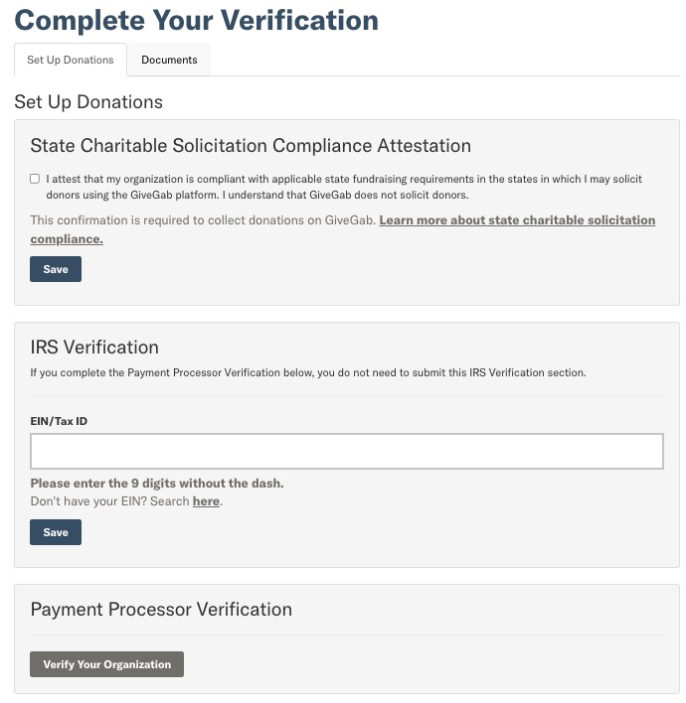
Get Verified
Notes:
Presenter Notes:
Go into more detail
Presenter Script:
Here’s a quick overview of what the Bank Account & Verification page looks like with the three major components of verification - state charitable solicitation attestation, EIN verification, and bank account/org representative verification.

Slide 25
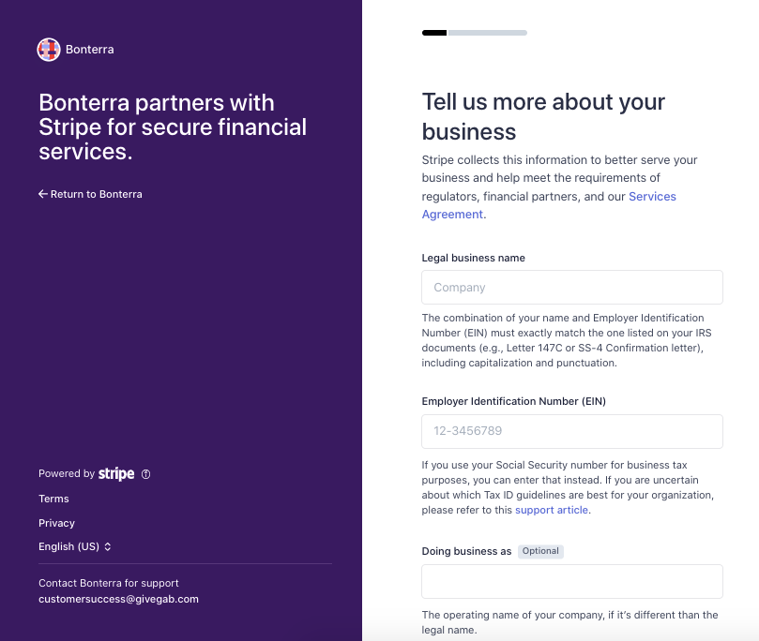
Get Verified
Notes:
Presenter Notes:
Go into more detail, point them in the direction of the support center
Presenter Script:
Here’s the secure Stripe portal where you’ll complete the payment processor verification.
We have a robust Help Center section to answer any questions you may have about the process of setting up verification, so be sure to check that out for additional information!

Slide 26
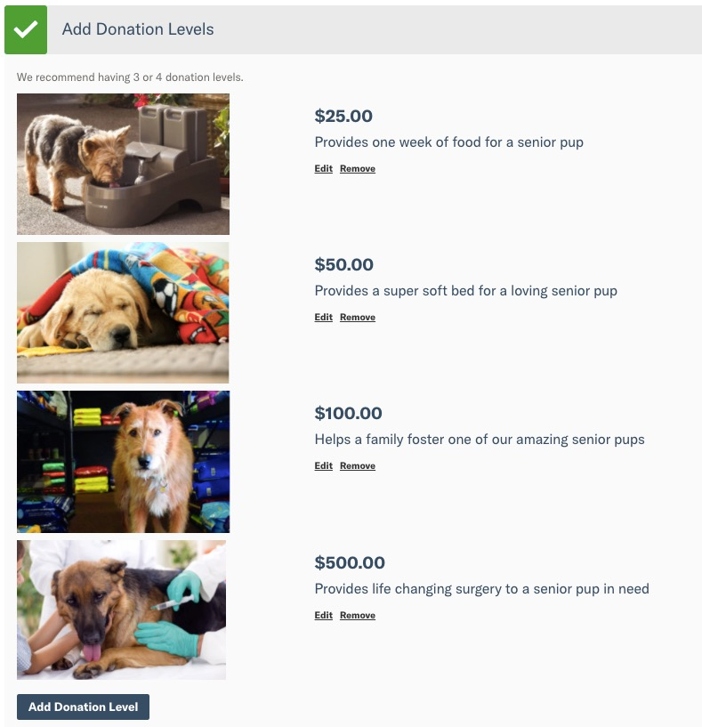
Suggest Donation Levels
Custom amounts
Unique descriptions
Optional photos
Unlimited Levels
Pro Tip: Using custom amounts to represent your organization, like a tangible good or service, further connects the donor to your goal
Notes:
Presenter Notes:
Custom amounts
Unique descriptions
Optional photos
Unlimited Levels
Pro Tip: Using custom amounts to represent your organization, like a tangible good or service, further connects the donor to your goal
Presenter Script:
Next, you’ll have the opportunity to set up suggested donation levels for your profile.
These suggested donation amounts can be tied to a specific program cost or organization expense, and can help donors visualize the impact that their gift will have. And don’t be afraid to get specific with the amounts!
For example, if you are an SPCA and it costs $35.85 to provide vaccines for a litter of kittens - that would make a great donation level. Donors will always have the option to donate a custom amount.

Slide 27
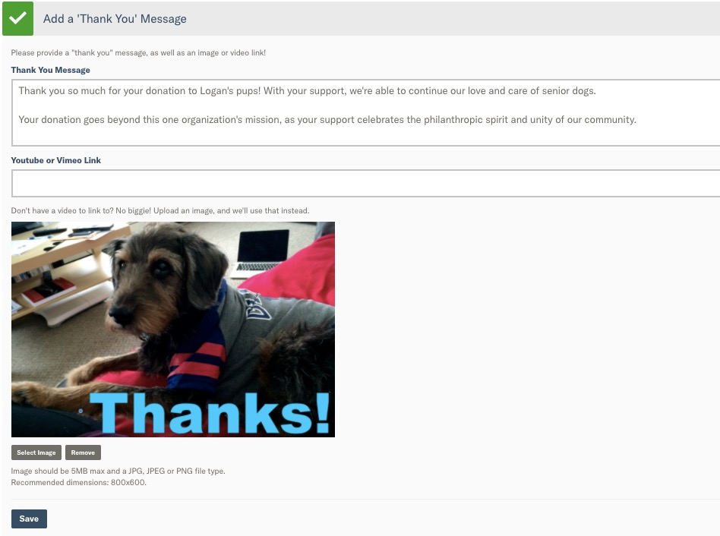
Personalized Gratitude
Add your own message
Include a photo or video for more personal stewardship!
Sent immediately to your donors when they complete their gift
Donors can reply to that email and contact you directly
Notes:
Presenter Notes:
Add your own message
Include a photo or video for more personal stewardship!
Sent immediately to your donors when they complete their gift
Donors can reply to that email and contact you directly
Presenter Script:
[Modify if day is centrally routed.] The next step is to add a thank you message. This is a custom thank you message that will be included on your donors’ tax-deductible receipt and is the first point of contact from your organization after they’ve made their donation.
Ensure that it is filled out with a personalized thank you message that includes an image or video if possible.
Thank you emails will automatically come from your organization’s main contact to provide an extra personal touch to donors.

Slide 28
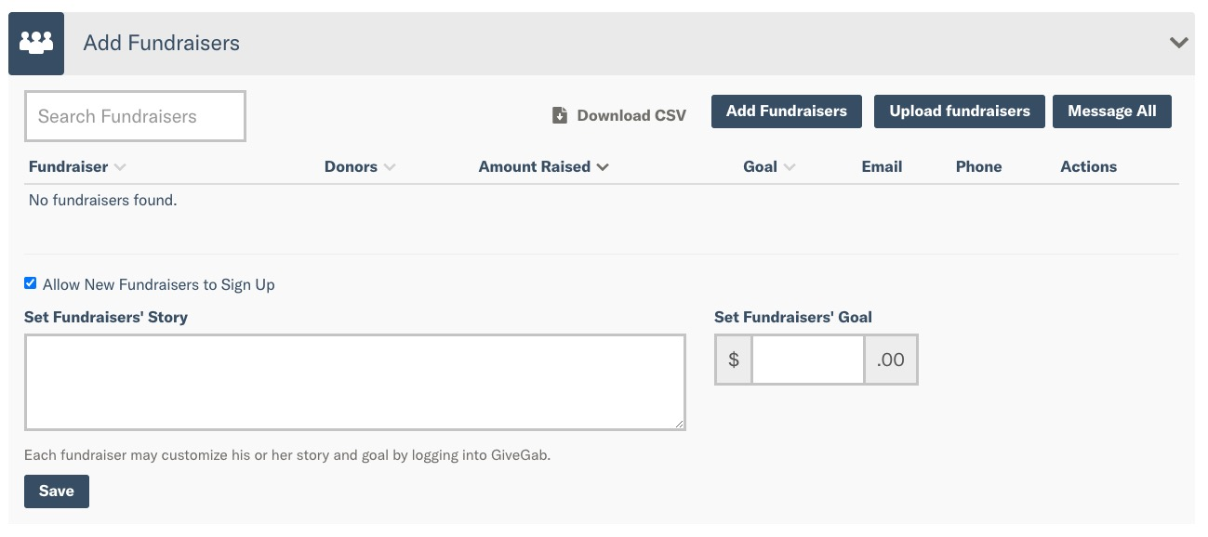
Invite Your Fundraisers
Ask supporters to reach out to their networks on your behalf
Each fundraiser creates their own page to collect donations. Their totals roll up into your totals!
Easily manage their pages
Pro Tip: Watch the Peer-to-Peer Fundraising Training Video
Notes:
Note: Quick live demo show where to find on your dashboard. Example: https://www.givegab.com/nonprofits/peninsula-community-foundation/giving_days/peninsulava2022
Presenter Notes:
Ask supporters to reach out to their networks on your behalf
Each fundraiser creates their own page to collect donations. Their totals roll up into your totals!
Easily manage their pages
Pro Tip: Watch the Peer-to-Peer Fundraising Training Video
Presenter Script:
The final checkbox on your Giving Day Dashboard is to Invite P2P Fundraisers. Adding fundraisers means that you are asking your existing supporters to reach out to their networks on your behalf to raise awareness and funds for your organization.
While this step is optional, organizations that use P2P fundraisers for their Giving Day strategy raise more funds on average than those who don’t.
Each P2P fundraiser creates their very own page to collect donations, and their totals roll right up into your totals.
While each P2P fundraiser is encouraged to set up their own profile, we understand that certain fundraisers may not have the time or know-how to do so. In this case, we make it easy for you to update their profiles for them. As an admin, you’ll be able to upload images, set a goal, and set a story for why that fundraiser is participating in Give Local!.
We have tons of great information available on [DoG URL] to help your fundraisers run a fantastic P2P campaign. Be sure to check out the P2P Fundraising Training Video and share it with your fundraisers.

Slide 29
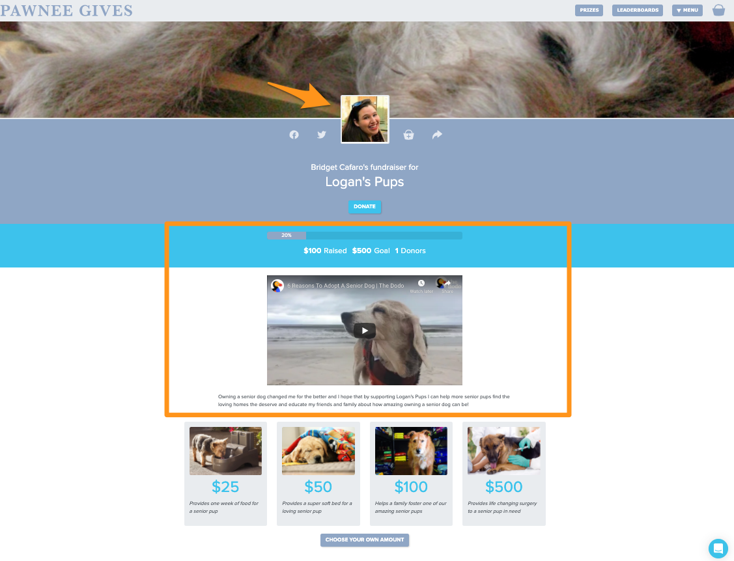
Notes:
Presenter Notes:
Here’s a quick example of a completed P2P fundraiser page.
Note the profile image, set goal, and custom video and blurb
All other branding is pulled in from your organization’s profile
Presenter Script:
Here is an example of a completed P2P Fundraising page. As you can see, the P2P Fundraiser has uploaded a profile image to help personalize their profile. They’ve also set a goal, and their progress towards that goal will be tracked once donations are open.
Additionally, they’ve entered a custom video explaining why they’re passionate about fundraising for this cause, as well as a little blurb.
Other than those personalized elements, the rest of the P2P Fundraising page is completely branded towards your organization and Give Local!.

Slide 30

Did you know?
Organizations who used P2P fundraising last year for Give Local! raised on average 2.4x more than those who did not.
Notes:
Note: Add your own stats from last year’s giving day if available from previous year’s debrief
Presenter Notes:
Organizations who used P2P fundraising last year for Give Local! raised on average [3.4x] more than those who did not.
Presenter Script:
As I mentioned earlier, organizations that use P2P fundraising raise more dollars than those who don’t. But did you know that they raise [3.4]x more than those that don’t? That is a significant difference. We hope that this will encourage you to find out how you can make P2P Fundraisers a large part of your Giving Day strategy.

Slide 31
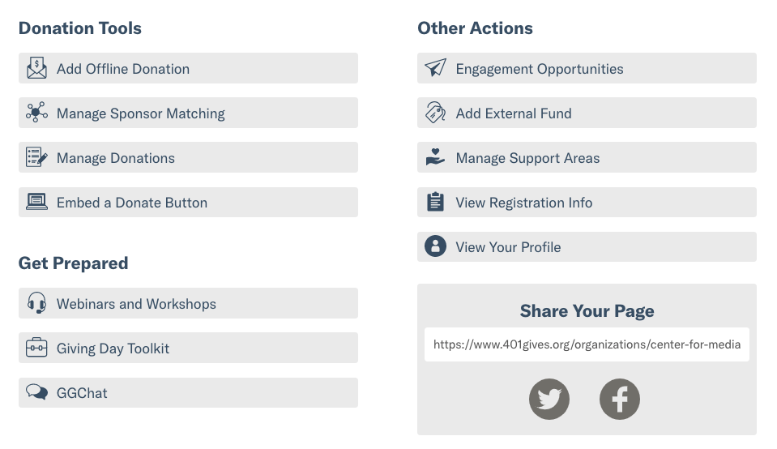
Key Dashboard Tools
Notes:
Presenter Notes:
Highlight additional actions that admins have available to them right within their Giving Day Dashboard
Especially call attention to offline donations, matching, and support areas
Presenter Script:
In addition to those [6] key steps to setting up your Giving Day profile, there are tons of additional tools to help you manage your Giving Day right from your dashboard.
For example, you’ll be able to add offline donations to your totals, manage sponsor matching, view a Giving Day scoped donation report and more.
From your dashboard we also provide quick access links to webinars and other training materials, our Giving Day toolkit, and Help Center.
Lastly, you’ll have the opportunity to provide external fund numbers to help code donations that come in through Giving Day, as well as add support areas, and view your profile as it’s being worked on.

Slide 32
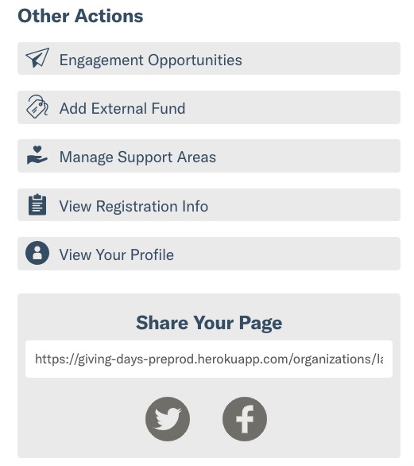
Share Your Profile
Preview your profile along the way
Share this link with your supporters
Post directly to Twitter and Facebook from your dashboard
Notes:
Presenter Notes:
Preview your profile along the way
Share this link with your supporters
Post directly to Twitter and Facebook from your dashboard
Presenter Script:
As you work through setting your profile up, you can easily view it by selecting the “View Your Profile” option beneath “Other Actions.”
Once your profile is fully completed and ready to share out to the world, you can use the link within the “Share your Page” box to share your Giving Day profile anywhere. You can also use the quick share buttons to easily share to Twitter and Facebook.

Slide 33

What’s Next?
Notes:
Presenter Notes:
So, what’s next?

Slide 34

Step Up Your Fundraising with Matches
Use pledged donations as a donor incentive to increase impact!
Once you secure a matching gift, utilize the Matching tool to add that money into your totals, according to the criteria you set.
1:1, 2:1, or 3:1 Matches
Donor, Dollar, or Donation Challenges
Pro Tip: Watch the Matching Training Video
Notes:
Presenter Notes:
Use pledged donations as a donor incentive to increase impact!
Once you secure a matching gift, utilize the Matching tool to add that money into your totals, according to the criteria you set.
1:1 Dollar-for-Dollar Matches
Donor or Dollar Challenges
Pro Tip: Watch the Matching Training Video
Presenter Script:
Before we wrap up today’s training, I want to highlight one last feature to help you take your Giving Day efforts to the next level -
Each organization has the opportunity to step up their Giving Day fundraising with Matches. Matches are an opportunity for you to secure additional funds in advance of Give Local! to help incentivise donor participation on the day of.
For example, you receive a $2,000 gift from a major donor or sponsor. You ask them if you can use this as a match, whereby every gift that comes in from an online donor will be matched dollar for dollar. A donor gives $10, $10 more dollars are added to your totals from that $2,000 gift until it runs out. Alternatively, you could set a goal, like 50 donors. When your organization reaches 50 donors, a $2,000 gift will be added to your totals! These are great ways to engage your supporters with specific messaging and asks, especially your p2p fundraisers.
Quick live demo show where to find on your dashboard (Example: https://www.givegab.com/nonprofits/peninsula-community-foundation/giving_days/peninsulava2022)

Slide 35

Did you know?
Organizations who had a match last year for Give Local! raised on average 4.5x more than those who did not.
Notes:
Note: Add your own stats from last year’s giving day if available!
Presenter Notes:
Organizations who had a match last year for Give Local! raised on average [4.5x] more than those who did not.
Presenter Script:
To emphasize just how effective matches are for increasing dollars raised on your giving day, organizations who had a match last year for Give Local! raised on average [4.5]x more than those who did not. Like with P2P fundraising, we encourage you to see how you can making matches a part of your giving day strategy.

Slide 36

Your Nonprofit Toolkit
The Nonprofit Toolkit has valuable resources for all your Give Local! needs.
Templates
Downloadable graphics
Resources for board members, volunteers, staff and fundraisers
Training videos for fundraising strategies!
Notes:
Presenter Notes:
The Nonprofit Toolkit has valuable resources for all your Give Local! needs.
Templates
Downloadable graphics
Resources for board members, volunteers, staff and fundraisers
Training videos for fundraising strategies!
Presenter Script:
Before we talk about next steps, I wanted to take some time to highlight the Nonprofit Toolkit.
The nonprofit toolkit is a valuable resources for all your Giving Day needs. It includes communication templates, downloadable graphics, resources for board members, volunteers, and fundraisers, as well as tons of on-demand training videos to help you prepare for Give Local!.
We encourage you to leverage these resources as you prepare for Giving Day, and feel encouraged to rely on them for your year round fundraising efforts as well!

Slide 37

Your Next Steps
Take a breath!
If this is your first time participating, enjoy it!
Your role as a nonprofit admin can seem overwhelming
You don’t need to compete for incentives and prizes
Give Local! may not be the right fit for all of your donors - that’s okay!
Notes:
Presenter Notes:
Take a breath!
If this is your first time participating, enjoy it!
Your role as a nonprofit admin can seem overwhelming
You don’t need to compete for incentives and prizes
Give Local! may not be the right fit for all of your donors - that’s okay!
Presenter Script:
So, now that we’ve covered how to register for and complete your profile for Give Local!, what are your next steps?
First, take a deep breath! There may seem like a ton of things to do for Give Local!, but if this is your first time participating, take a step back and decide on what extra strategies you’ll want to take on if any.
We understand that your role as a nonprofit admin can seem overwhelming, as you may be working with very limited resources. We hope that the resources that we provide will help to make your participation in Give Local! a bit easier.
Remember that while there are opportunities to secure match incentives and prizes, you don’t need to complete for these. Do what is within your capacity to do, and remember that there are always future years to take your participation to the next level.
And finally, remember that giving through Give Local! may not be the right fit for all your donors - and that’s okay! Giving Day is a great opportunity to help take existing donor relationships to the next level, while also taking advantage of an amazing opportunity to get your organization in front of new audiences. It may not be the right fit for everyone, but it’s still an amazing way to nurture certain supporter relationships.

Slide 38

Your Next Steps
What to work on over the next couple months:
Follow Give Local! on Social Media and use #GiveLocalSC! Hashtag
Watch your inbox for important emails
Meet internally to discuss goals
Sign up for upcoming webinars
Explore the toolkit
Notes:
Presenter Notes:
What to work on over the next [X months/weeks]:
Follow Give Local! on Social Media and use #Give Local! Hashtag
Watch your inbox for important emails
Meet internally to discuss goals
Sign up for upcoming webinars
Explore the toolkit
Presenter Script:
Over the next few weeks, take some time to do the following -
Follow Give Local! on social media and remember to use the hashtag #[hashtag] when posting about Give Local!
Watch your inbox for important emails from both GiveGab/Bonterra and [Partner Organization] - this will be our main method of communication with you as you prepare for Giving Day, and we don’t want you to miss out on any important information!
If you have others in your organization that you’ll be working with on your Giving Day efforts, consider meeting internally to discuss what goals you have for Give Local!
Mark your calendar for the upcoming webinars and make sure to register
And lastly, explore the toolkit to see what resources your organization can leverage this year!

Slide 39
Questions?
November 14, 2025
Notes:
Presenter Notes:
Thank organizations for attending
Transition to answering questions that came in via the Q&A box
If possible, also monitor the chat to see if any were accidentally sent through there
Presenter Script:
Thank you all so much for joining us today for Getting Ready for Give Local!! We went over a TON of information in this presentation, and as a reminder, we will have the slides and recording available on the trainings page of [DoG URL] shortly. At this time, we’ll address any questions that you might have. If you haven’t submitted your question yet, make sure to find your Q&A box and submit them now.
Toss back to hannah

Slide 40
Give Local is an annual event designed to celebrate the
causes that matter
to the people of Chester and Lancaster Counties, ​South Carolina.

Slide 41
History of Give Local ​
Launched in 2016, Give Local is a community awareness campaign designed to connect community members to certified local nonprofits and to raise funds to support their missions. The campaign supports nonprofits providing services in Chester and Lancaster Counties, South Carolina.
Since inception, Give Local has raised over $3 million for over 100 local nonprofit organizations.

Slide 42
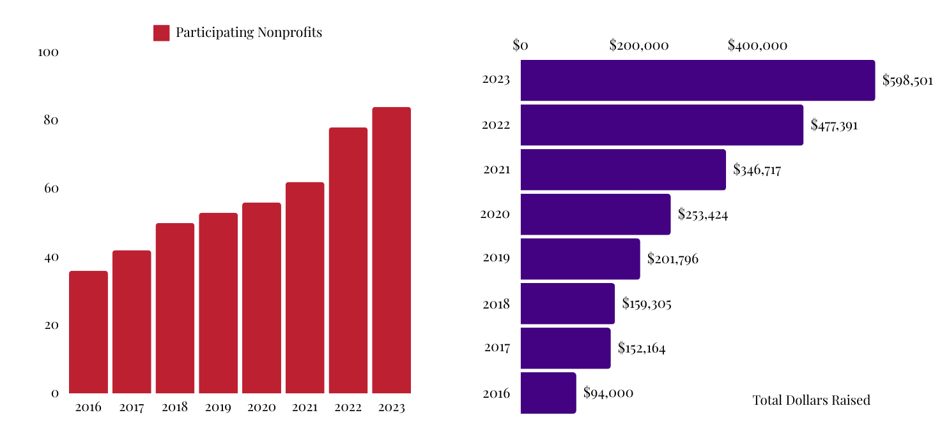
History of Give Local ​

Slide 43
RAISED DURING GIVE LOCAL 2024
! NEW RECORDS MADE !
$720,448
gave
to
2,171+
donors
3,165+
gifts
93
NPOs

Slide 44
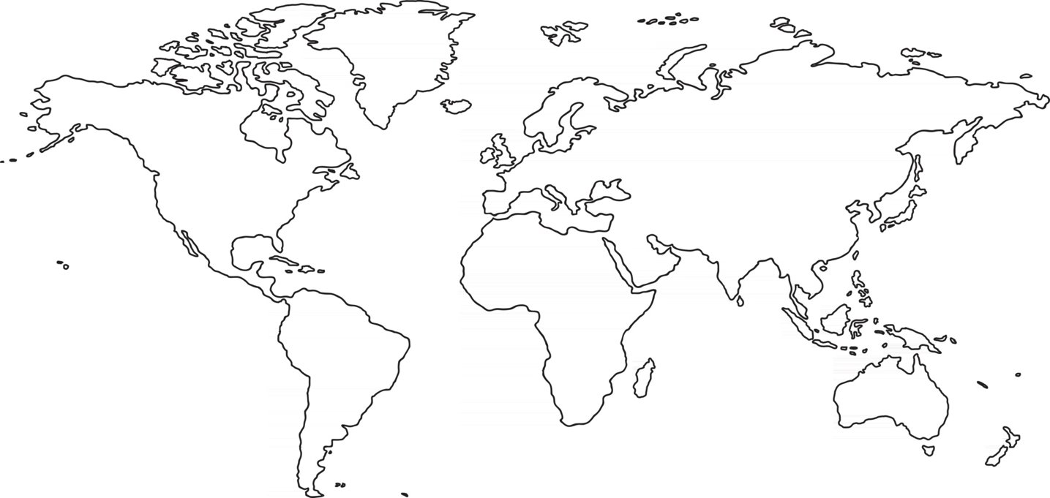

Giving Local Around the Globe, 2024

Slide 45

CELEBRATING

Slide 46
November 14, 2025
National Philanthropy Day
Celebrated annually on November 15

Slide 47
🗓️ Key Dates for 2025:
September 15: GL25 KICKOFF &Training
October 15: GL25 registration closes
November 1: Give Local! Blitz 💥
November 14, 2025: Give Local! 2025
Give Local 2025 "Office Hours"
September 18 (for new orgs, 2:30-4:30pm)
October 2 & 3 (drop in, 10am-1pm)
October 13 & 14 (drop in, 2pm-5pm)
October 30 (drop in, 3pm-5pm)
November 7 (as needed, by appointment only)

Slide 48
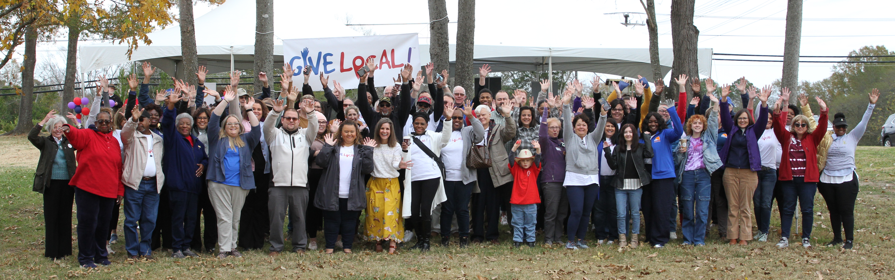
Live events schedule: Stay Tuned…

Slide 49

Registration is OPEN!
Nonprofit registration is open until October 15.
Early planning = exceeding goals for Give Local.
Currently, 63 organizations are registered.

Slide 50
A Successful
Campaign

Slide 51

What is storytelling?
Using a narrative to connect your mission to individuals; focus on linking what you stand for to the values you share with your supporters.
Storytelling has the unique ability to connect with the people who care about your nonprofit’s mission on an emotional level, helping them understand the impact of their contributions and inspiring them to support your cause
Notes:
Internal: Healthy communities thrive when all people join together using their individual strengths and gifts to support and celebrate each other.

Slide 52
6 Reasons to Embrace NPO Storytelling
Storytelling humanizes the work you do
Nonprofit storytelling empowers your advocates
Where the written word fails, photos & videos thrive
Stories stick with us
Nonprofit storytelling enhances transparency
Great stories inspire action
Source: National Council of Nonprofits (article)

Slide 53

How do YOU tell your stories during GL?
Let’s discuss…

Slide 54
Utilize all tools available to you!
Complete Profile (help donors who might not know you get to know you!)
  RE-SELECT YOUR 3 CAUSES… donor filtering
Give Local Promotion (NPO toolkit, share share share!)
Personalized Give Local Promotion (Canva templates)
Full Marketing Campaign (email campaign, enlist your circles!)

Slide 55
SET GOALS!
Fun Fact: 77% of organizations in 2024 met or exceeded their GL goals.
Plan early, set goals…What goals are most meaningful for your organization?
  Board & staff engagement
  $ Monetary goal
  # Donor goal

Slide 56
STRATEGIZE!
You have your goals, who is going to help you achieve them?
  Board member participation
  Peer-to-peer fundraisers
  Social media warriors
  Clear roles & expectations
  Targeting specific awards
Tools:
  SOCIAL MEDIA
  Email Campaigns
  Canva.com (Graphics)
Organizations who had a match last year for Give Local! raised on average 4.5x more than those who did not.

Slide 57

Tools to Superpower your day
Matches
  $280,381.44 was raised through matches in 2024, up from $196,152 in 2023.
Special Awards… think strategically
Free graphics and support from the Arras team!

Slide 58

How have you found
Give Local success?
Let’s discuss…

Slide 59

Matches & Awards*

Slide 60



100% Board Engagement
Learning & Leading Together
Storytelling Extraordinaire

Slide 61
Chances to double your fundraising!
$1000 for 10 Years! Every dollar raised on Give Local Day will be matched by the Arras Foundation until your organization hits $1,000. Only money raised or entered by your organization on Give Local Day eligible.
10 Minutes to Win it x2! Fire up your donors, it's time for dollar-to-dollar beat the clock matches! At 10AM AND 10PM. For TEN Minutes, Arras Foundation will match all funds raised up to $1,000 (from 10:00am to 10:10am and from 10:00pm to 10:10pm) in celebration of TEN years of Give Local.

Slide 62
Match Opportunities up to
$3,000 for EVERY organization participating in Give Local 2025!

Slide 63

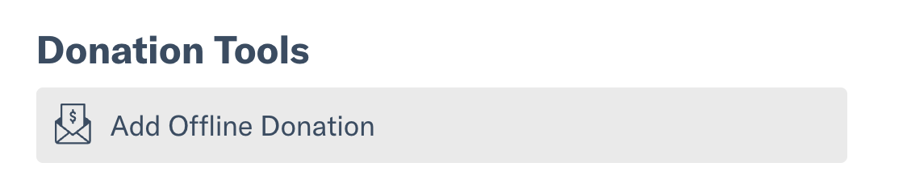


Let’s talk about check/cash donations…
Checks need to be DATED for November 14
Cash/check donations need to be entered into the GiveGab system as “Offline Donations” on Give Local day to count for matches/awards
If the Arras Foundation receives checks…
  If you KNOW your own donors are likely to give by cash/check, come up with your own strategy!

Slide 64
🗓️ Key Dates for 2025:
September 15: GL25 KICKOFF &Training
October 15: GL25 registration closes
November 1: Give Local! Blitz 💥
November 14, 2025: Give Local! 2025
Give Local 2025 "Office Hours"
September 18 (for new orgs, 2:30-4:30pm)
October 2 & 3 (drop in, 10am-1pm)
October 13 & 14 (drop in, 2pm-5pm)
October 30 (drop in, 3pm-5pm)
November 7 (as needed, by appointment only)

Slide 65
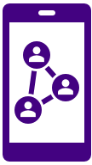




Follow along in the fun!
@ArrasFoundation
Add GiveLocal@arrasfoundation.ccsend.com
to your email's safe-senders list.
Constant Contact will be our primary mode of communication!

Slide 66
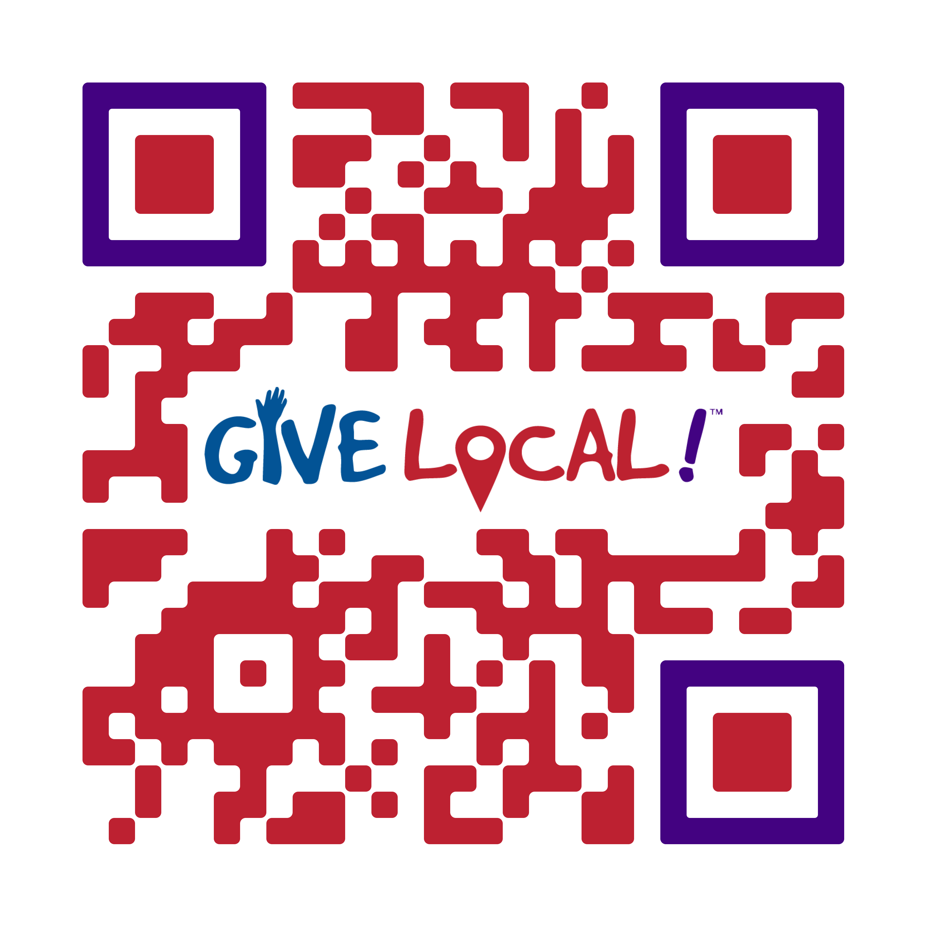

Questions?
GiveLocal@arrasfoundation.org
803-286-8772
---
Emma DeVenny, Communications Director
emma@arrasfoundation.org

